Slide 1
A Bioinformatic Workflow for Transcriptome Analysis of Opsin genes in Ephemeroptera (Mayflies)
Ernie Vilela

Slide 2
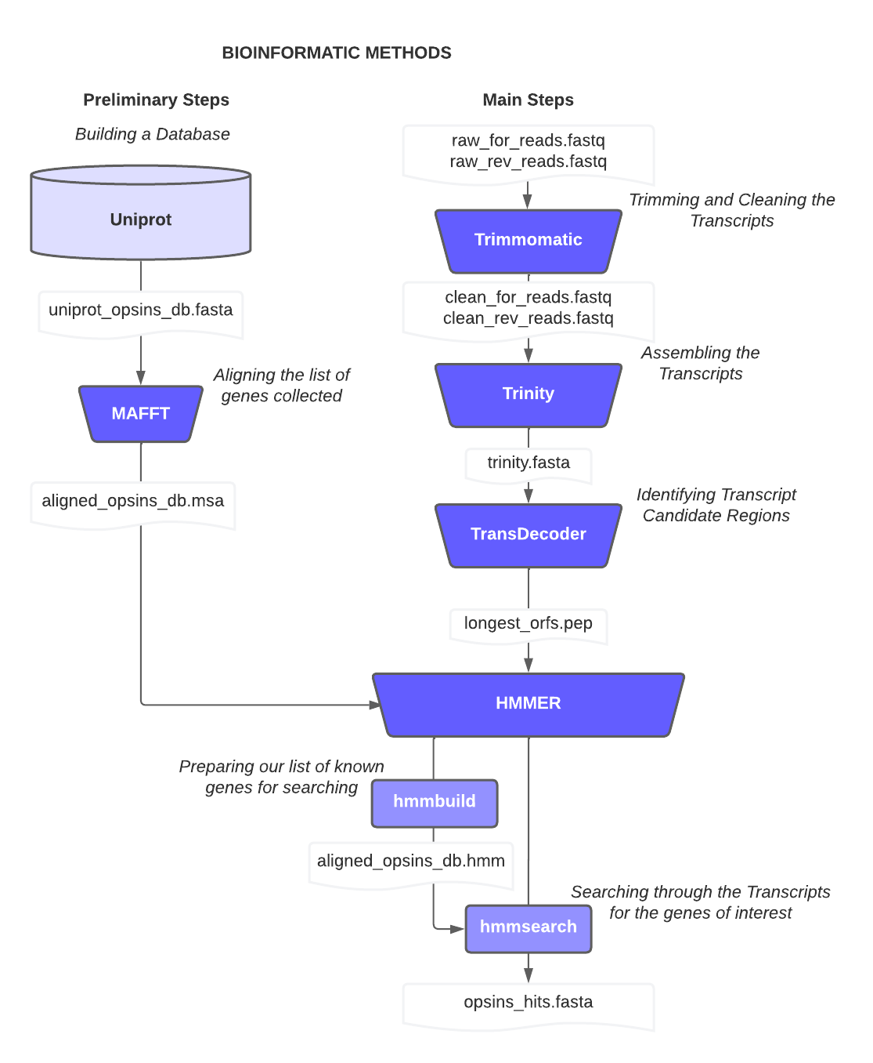
BACKGROUND

Slide 3
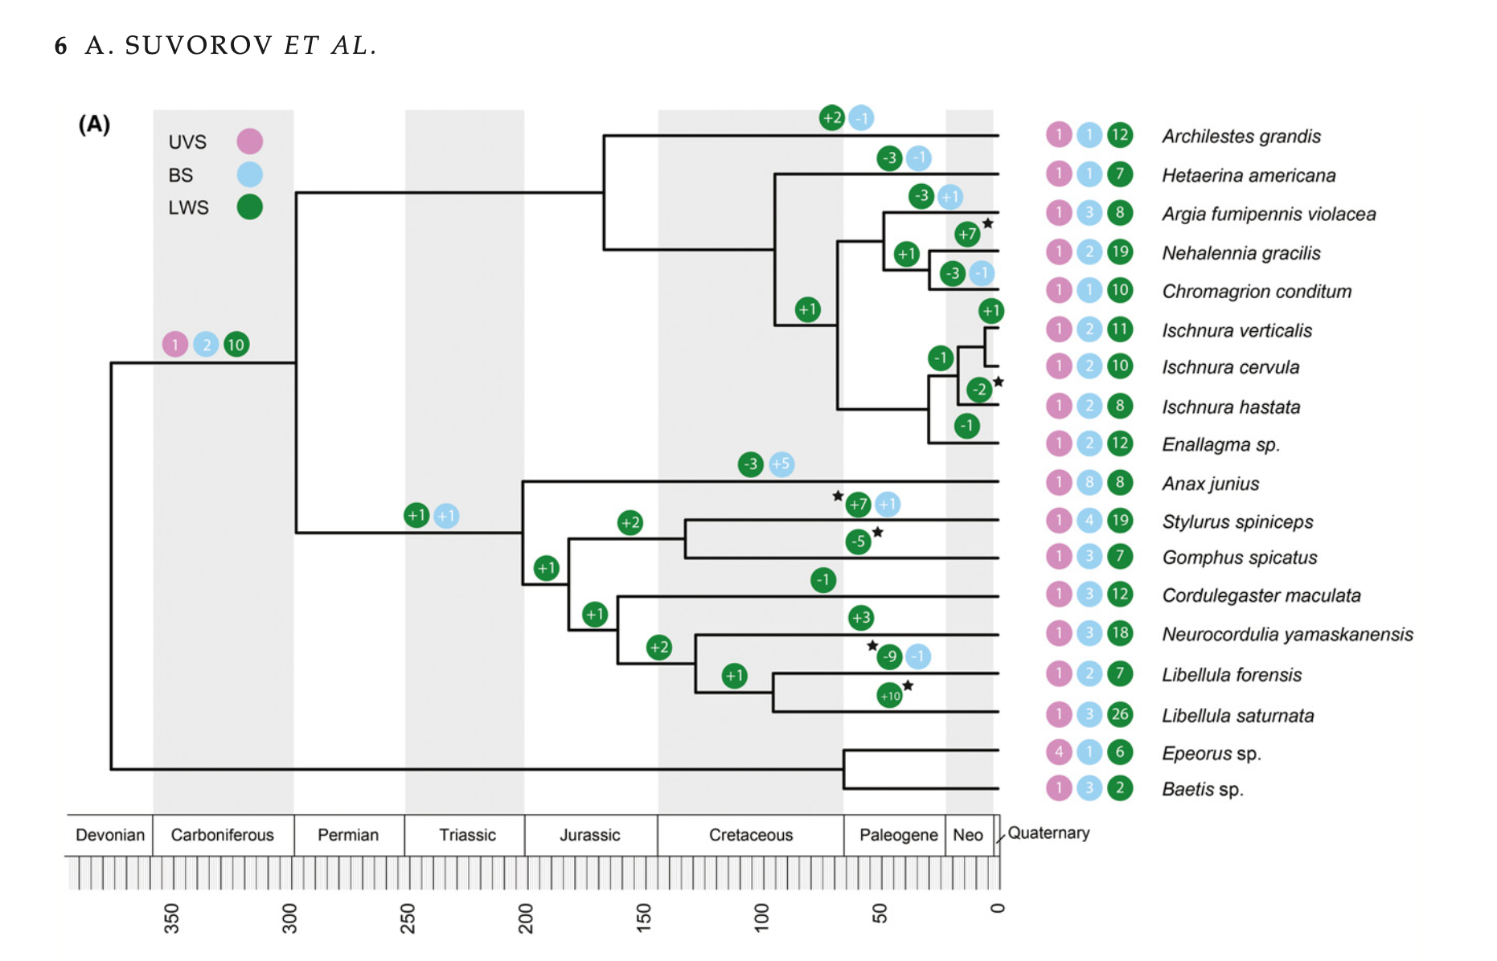
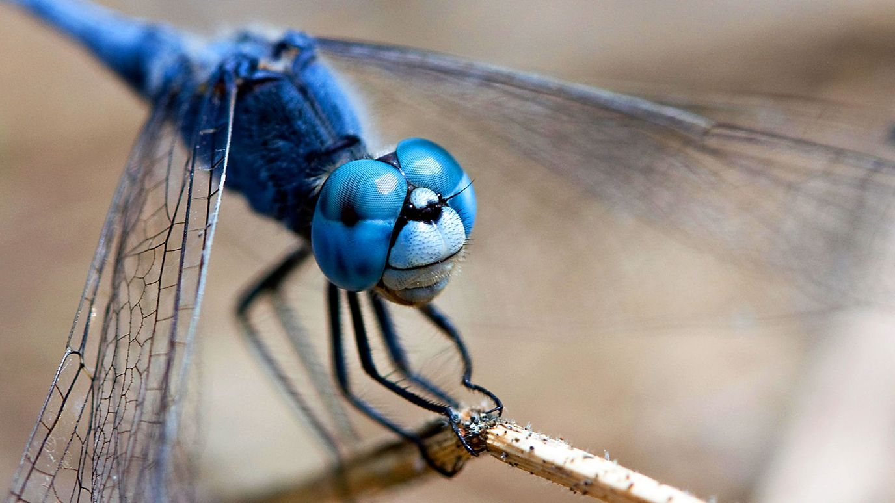
DRAGONFLIES (ODONATA)

Slide 4
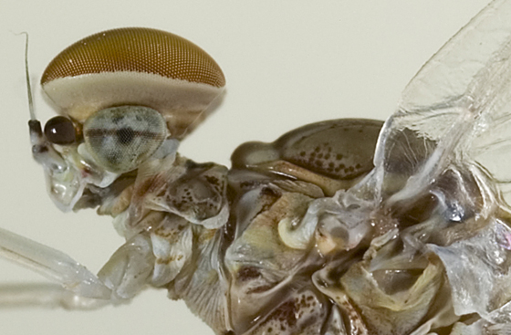
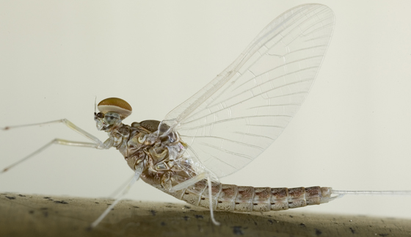
MAYFLIES EYES
Beatidae

Slide 5
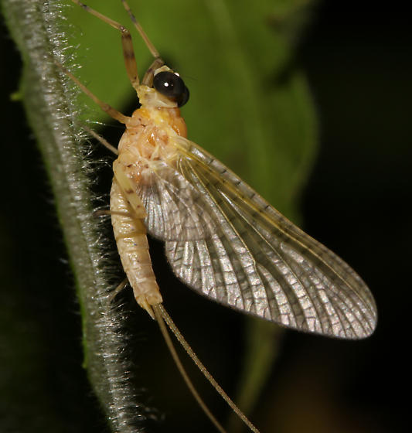
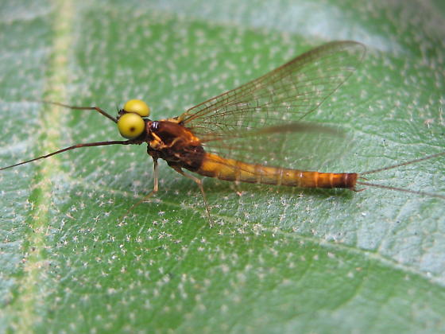
MAYFLIES EYES
Heptageniidae

Slide 6
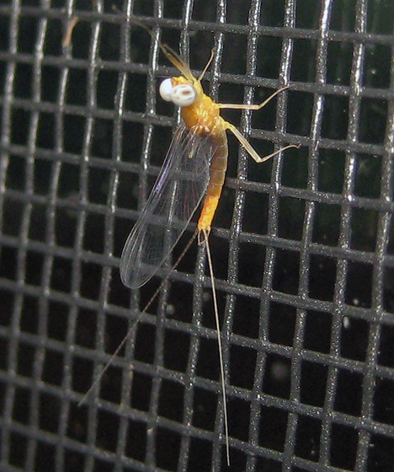
Mayflies Eyes
Ephemeridae

Slide 7
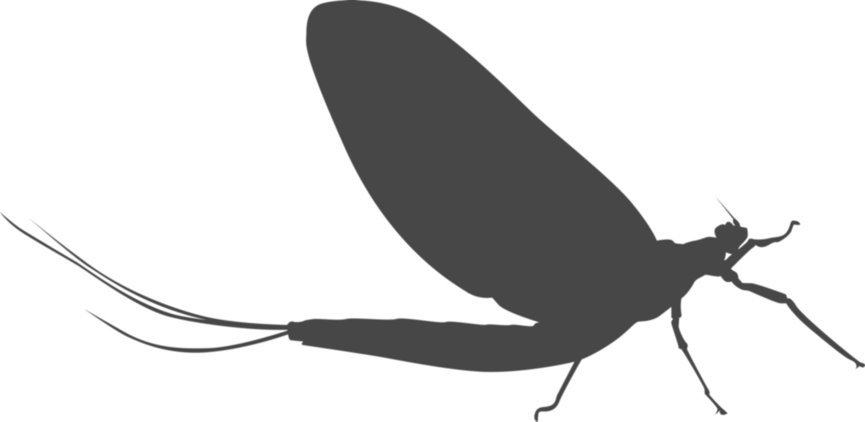
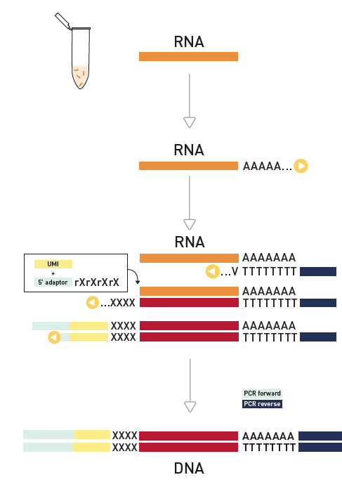

9 Mayflies
9 Transcriptomes

Slide 8
THE WORKFLOW PRELIMINARY STEPS

Slide 9
THE PIPELINE

Slide 10
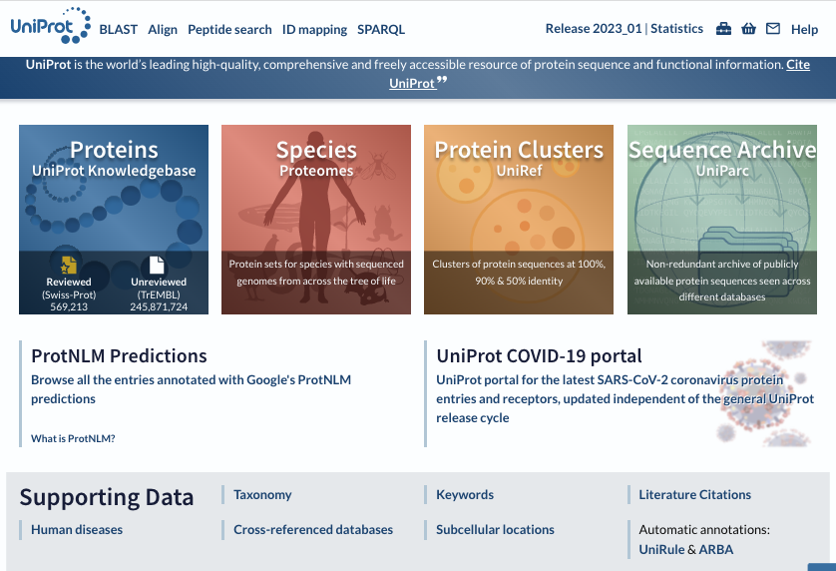

BUILDING A DATABASE

Slide 11
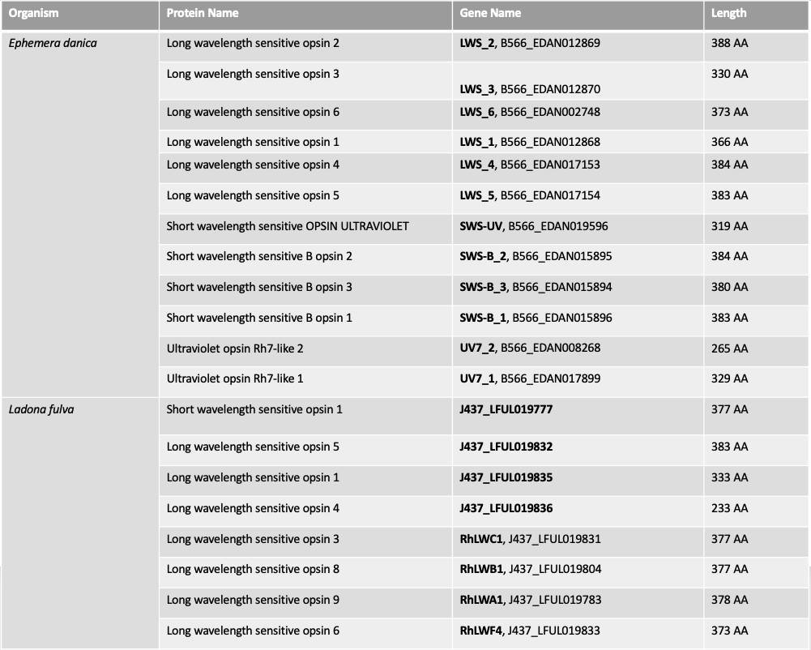

BUILDING A DATABASE
DATA DOWLOAD
uniprot_opsins_db.fasta

Slide 12

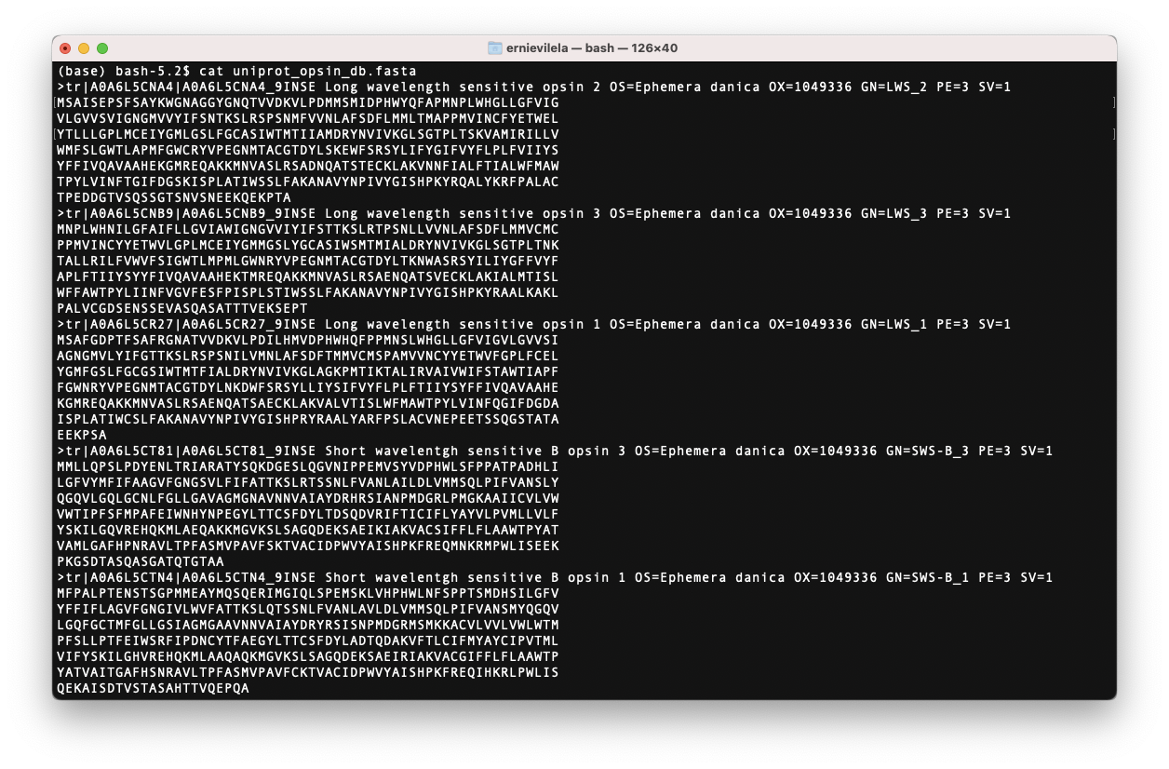
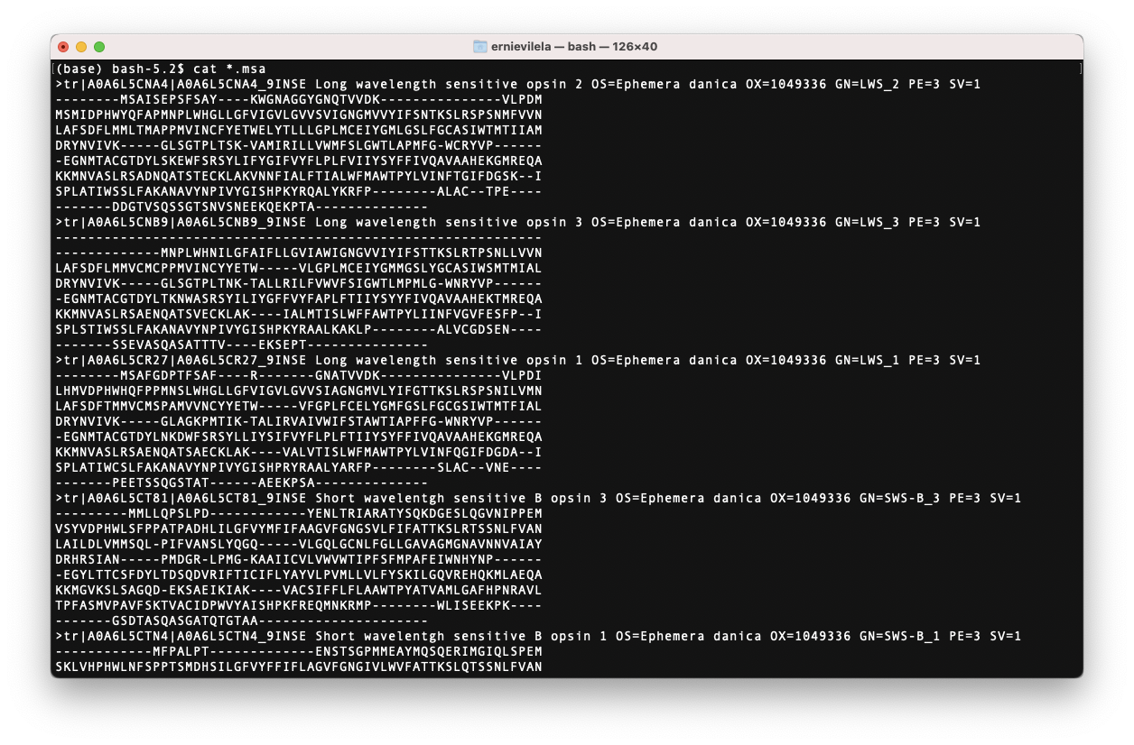
BUILDING A DATABASE
ALIGNMENT
$../mafft-mac/mafft.bat uniprot_opsin_db.fasta > aligned_uniprot_opsin_db.msa

Slide 13

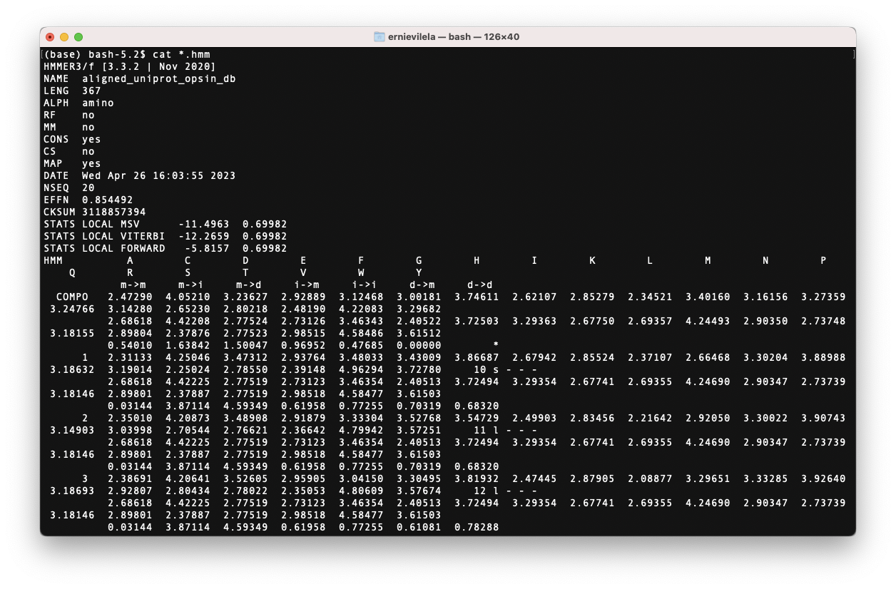
BUILDING A DATABASE
BUILDING A PROFILE
$hmmbuild hmmb_aligned_uniprot_opsin_db.hmm aligned_uniprot_opsin_db.msa

Slide 14

THE PIPELINE

Slide 15
THE WORKFLOW MAIN STEPS

Slide 16
THE PIPELINE

Slide 17
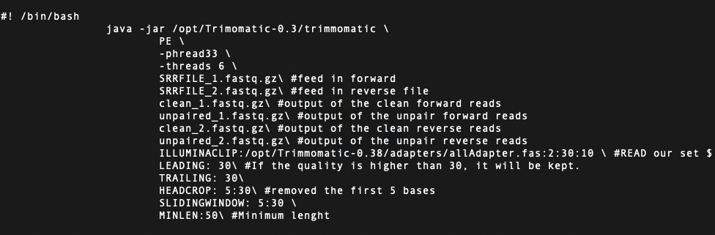

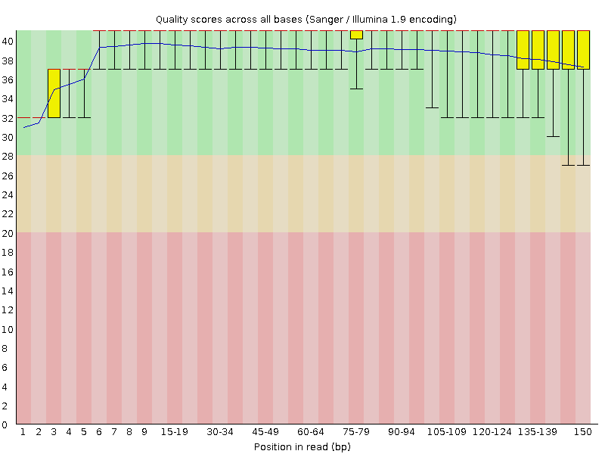

TRIMMING AND CLEANING
ALIGNMENT
FastQC

Slide 18

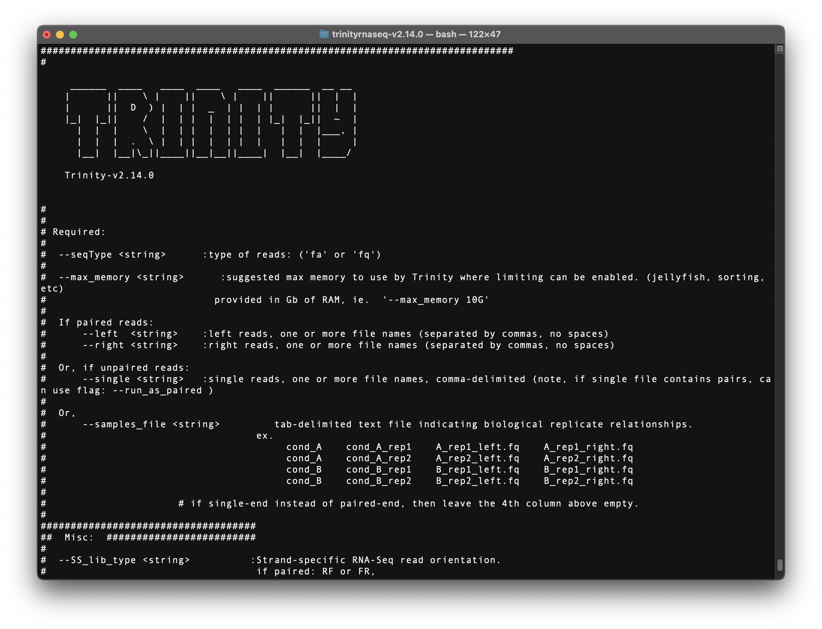
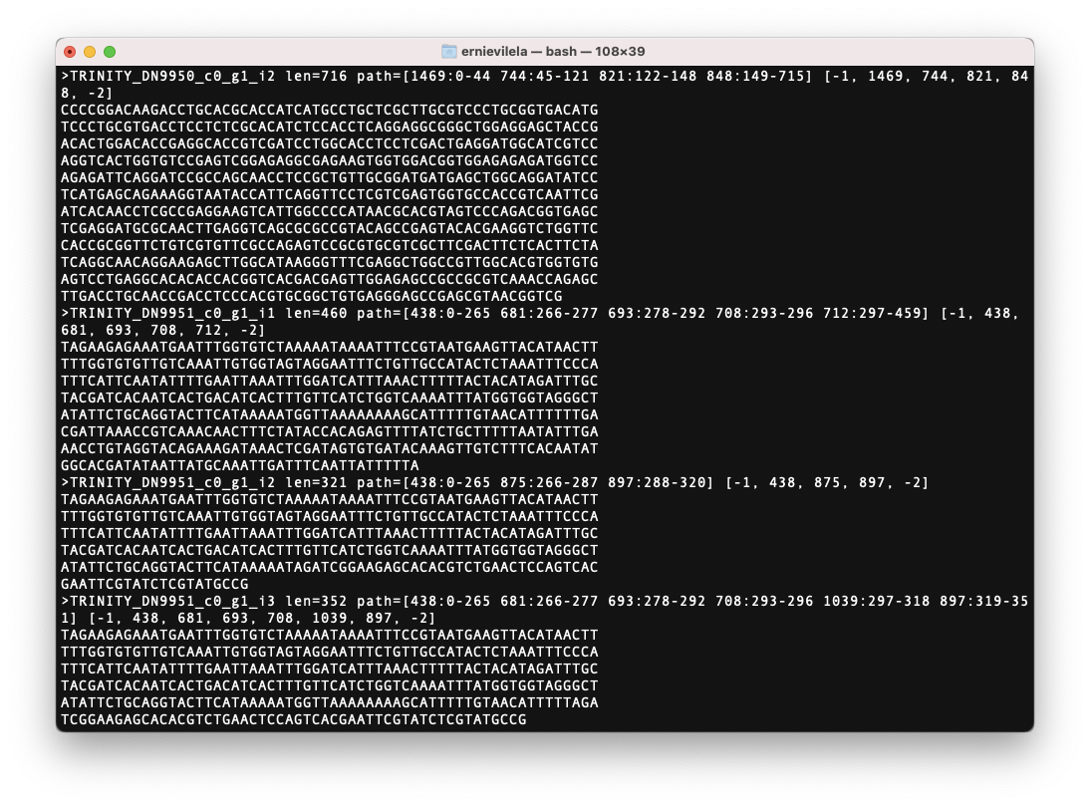
TRANSCRIPT ASSEMBLY
$ .../opt/trinity/Trinity/ --seqType fq --max_memory 50G --left clean_1.fq --right clean_2.fq --CPU 2 --SS_lib_type RF

Slide 19
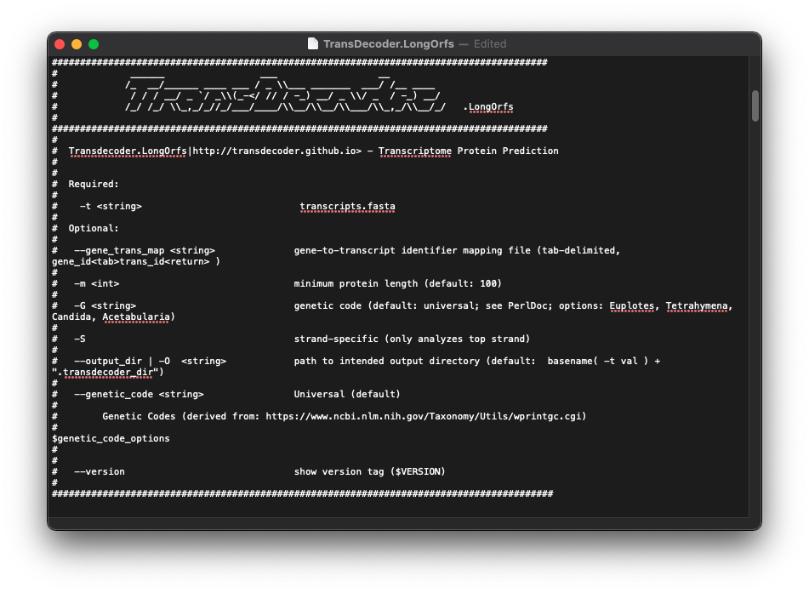

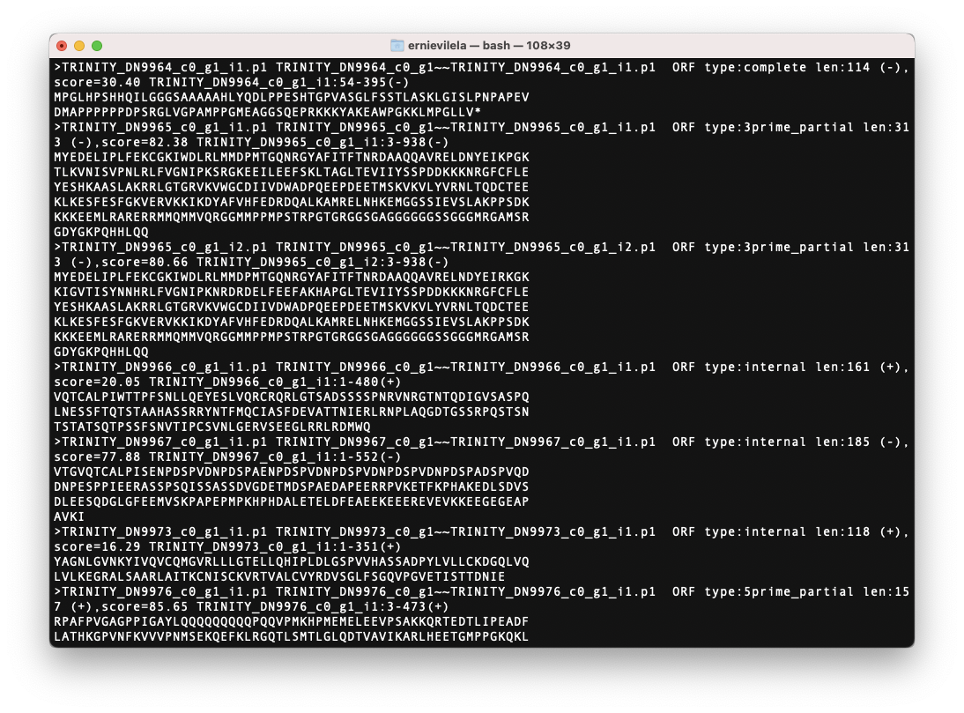
IDENTIFYING CANDIDATE CODING REGIONS
longest_orfs.pep
Notes:
Extract long open reading frames: TransDecoder.LongOrfs -t trinity_output.fasta
Predict the likely coding regions: TransDecoder.Predict -t target_transcripts.fasta [ homology options ]

Slide 20
THE PIPELINE

Slide 21

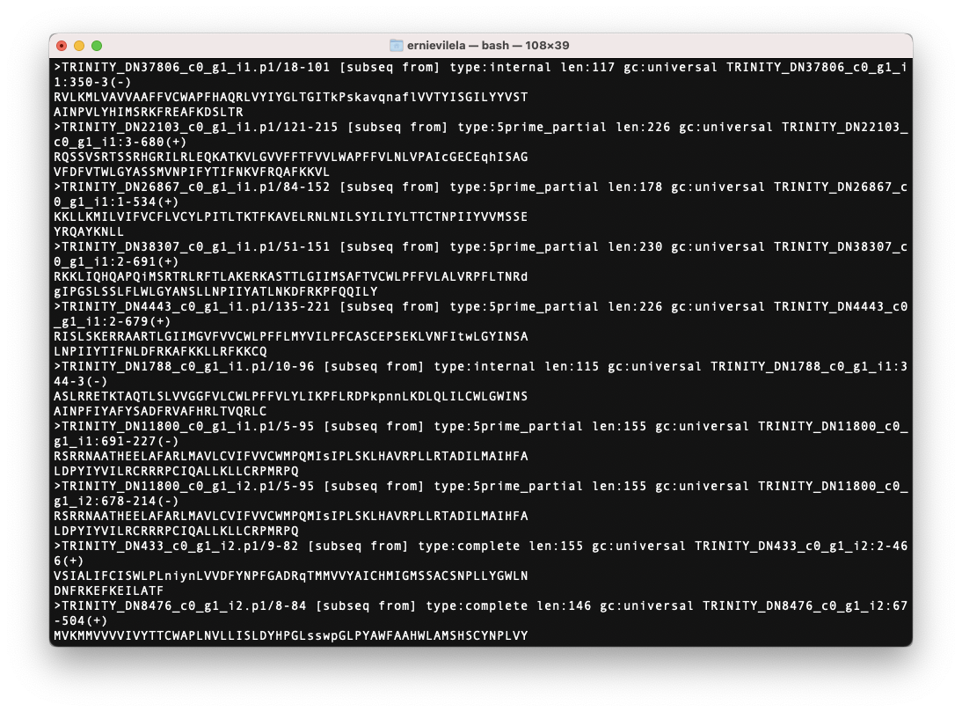
SEARCHING FOR HOMOLOGOUS SEQUENCES
aligned_opsins_db.hmm
hmmrsearch
longest_orfs.pep
opsin_hits.fasta
Notes:
Extract long open reading frames: TransDecoder.LongOrfs -t trinity_output.fasta
Predict the likely coding regions: TransDecoder.Predict -t target_transcripts.fasta [ homology options ]

Slide 22
THE PIPELINE

Slide 23
RESULTS

Slide 24
LIST OF SPECIMEN AND OPSIN GENE COUNT
Family | Genus | Species | Total Opsin Genes Count
Baetidae | Cloeon | dipterum | 31
Baetidae | Cloeon | dipterum | 16
Baetidae | Cloeon | dipterum | 6
Ephemeridae | Hexagenia | rigida | 28
Baetidae | Callibaetis | sp. | 35
Baetidae | Callibaetis | fluctuans | 10
Baetidae | Beatis | sp. | 21
Heptageniidae | Stenacron | interpunctatum | 24
Heptageniidae | Stenacron | interpunctatum | 7

Slide 25
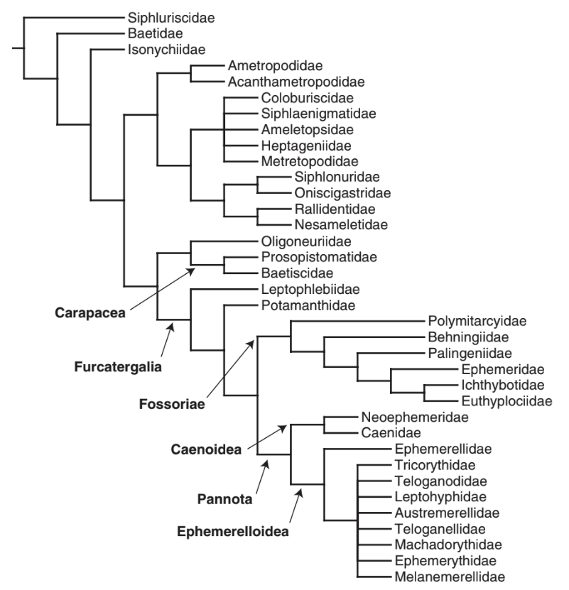
Opsin count: 6, 10, 16, 21, 31, 35
Opsin count: 7, 24
Opsin count: 28
(Ogden et al, 2009)

Slide 26
Future Work
Filter for Repeats
Specify Opsin type (LW, SW, UV)
Take into account life stage of specimens.

Slide 27
THE PIPELINE

Slide 28
QUESTIONS

